Slide 1
Domain DL
Technology: Python
FAKE REVIEWS DETECTION USING SUPERVISED MACHINE
LEARNING

Slide 2
INDEX
Abstract
Introduction
Literature review
Existing Method
Drawbacks
Proposed method
Advantages
Implementation
Modules
Algorithms
Hardware and Software Requirements
Architecture
UML diagrams
Results
Conclusion
Future Scope
References

Slide 3
ABSTRACT
With the continuous evolve of E-commerce systems, online reviews are mainly considered as a crucial factor for building and maintaining a good reputation. Moreover, they have an effective role in the decision making process for end users. Usually, a positive review for a target object attracts more customers and lead to high increase in sales. Nowadays, deceptive or fake reviews are deliberately written to build virtual reputation and attracting potential customers. Thus, identifying fake reviews is a vivid and ongoing research area. Identifying fake reviews depends not only on the key features of the reviews but also on the behaviours of the reviewers. This paper proposes a machine learning approach to identify fake reviews. In addition to the features extraction process of the reviews, this paper applies several features engineering to extract various behaviours of the reviewers. The paper compares the performance of several experiments done on a real Yelp dataset of restaurants reviews, we compare the performance of machine learning classifiers; KNN, Naive Bayes (NB), Logistic Regression. The results reveal that Logistic Regression outperforms the rest of classifiers in terms of accuracy achieving best. The results show that the system has better ability to detect a review as fake or original.

Slide 4
INTRODUCTION
Nowadays, when customers want to draw a decision about services or products, reviews become the main source of their information. For example, when customers take the initiation to book a hotel, they read the reviews on the opinions of other customers on the hotel services.
Depending on the feedback of the reviews, they decide to book room or not. If they came to a positive feedback from the reviews, they probably proceed to book the room
The rise of social media has blurred the line between authentic content and advertising, leading to an explosion in deceptive endorsements across the marketplace. Fake online reviews and other deceptive endorsements often tout products throughout the online world.

Slide 5
Usually, fake reviews detection depends not only on the category of reviews but also on certain features that are not directly connected to the content. Building features of reviews normally involves text and natural language processing NLP.
However, fake reviews may require building other features linked to the reviewer himself like for example review time/date or his writing styles.
Thus the successful fake reviews detection lies on the construction of meaningful features extraction of the reviewers.

Slide 6
LITERATURE SURVEY
S. NO | Journal Type with year | Authors | Title | Outcomes
1 | JOURNAL, 2019 | R. Barbado, O. Araque, and C. A. Iglesias | A framework for fake review detection in online consumer electronics retailers | R. Barbado, O. Araque, and C. A. Iglesias proposes a feature framework for detecting fake reviews that has been evaluated in the consumer electronics domain.
2 | IEEE,2016 | Tadelis | The economics of reputation and feedback systems in e-commerce marketplaces | Tadelis discuss ways to address these problems to improve the practical design of online marketplaces and suggest some directions for future research.

Slide 7
S. NO | Journal Type with year | Authors | Title | Outcomes
3 | JOURNAL,2018 | M. J. H. Mughal | Data mining: Web data mining techniques, tools and algorithms: An overview | M. J. H. Mughal concluded that using different techniques, tools, approaches, algorithms for discover information from huge bulks of data over the web performed well.
4 | JOURNAL,2018 | C. C. Aggarwal | Opinion mining and sentiment analysis,” in Machine Learning for Text. | C. C. Aggarwal defined problem of opinion mining and sentiment analysis as the computational analytics associated with such text.

Slide 8
S. NO | Journal Type with year | Authors | Title | Outcomes
5 | JOURNAL,2013 | A. Mukherjee, V. Venkataraman, B. Liu, and N. Glance | What yelp fake review filter might be doing | Analysed experimental results allow us to postulate that Yelp’s filtering is reasonable and its filtering algorithm seems to be correlated with abnormal spamming behaviours.
6 | JOURNAL,2007 | ] N. Jindal and B. Liu | Review spam detection | They make an attempt to study review spam and spam detection. To the best of our knowledge, there is still no reported study on this problem.

Slide 9
EXISTING METHOD
The increasing growth of machine learning, computer techniques divided into traditional methods and machine learning methods.
This section describes the related works of fake review detections and how machine learning methods are better than traditional methods.
The existing method in this project have a certain flow and also RF is used for model development. But it requires large memory and result is not accurate.

Slide 10
DISADVANTAGES
Low Accuracy
High complexity
Highly inefficient.
Requires skilled persons

Slide 11
PROPOSED SYSTEM
We propose this application that can be considered a useful system since it helps to reduce the limitations obtained from traditional and other existing methods.
The objective of this study to develop fast and reliable method which detects and estimates anaemia accurately.
To design this system is we used a powerful algorithm in a based Python environment with Django frame work.

Slide 12
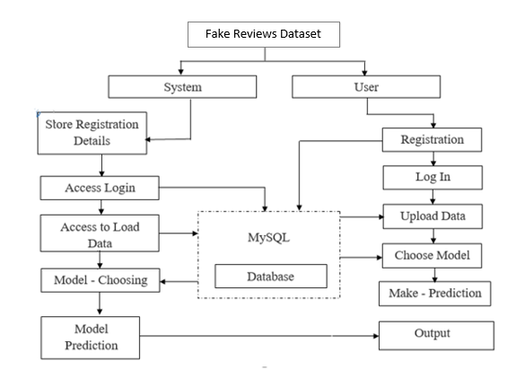
PROPOSED METHOD

Slide 13
ADVANTAGES
High efficiency.
Time Saving.
Inexpensive.
Low complexities.

Slide 14
IMPLEMENTATION
Firstly, we have collected anemia related dataset.
Later we will load the collected dataset to our working environment.
Necessary pre-processing steps will be completed here before building our required model.
Dividing the data into train and test splits
Perform building machine learning model in a flask environment using Python
The model has been built with Lasso and Ridge regressions.
Designed as, the system delivers the prediction results to the user depending on the inputs entered.
User need to register and login to the application in order to enter the environment which is designed by using SQL.

Slide 15
MODULES
1. System
1.1 Take Dataset:
The System receives data given by the user.
1.2 Model Training:
The user can select model based on the variables to get response from the data and can predict the outputs from the model.
1.3 Generate Results:
The system can deliver the predicted results and can be displayed to the user.

Slide 16
MODULES
2. User
2.1 Registration:
Every new user needs to register themselves in the system with a unique name and email.
2.2 Login:
Registered users can log in to the system.
2.3 Upload and View Data:
After logging in successfully, the user can upload and view their uploaded dataset.
2.4 Splits and Select Model:
The user can select the desired split ratio and can choose the required model to view the result from the dataset.
2.5 Prediction:
The user can predict outcomes from the system.
2.6 Logout
User logout from the system

Slide 17
ALGORITHMS
1. KNN:
K-Nearest Neighbour is one of the simplest Machine Learning algorithms based on Supervised Learning technique.
K-NN algorithm assumes the similarity between the new case/data and available cases and put the new case into the category that is most similar to the available categories.
K-NN algorithm stores all the available data and classifies a new data point based on the similarity. This means when new data appears then it can be easily classified into a well suite category by using K- NN algorithm.
K-NN algorithm can be used for Regression as well as for Classification but mostly it is used for the Classification problems.

Slide 18
K-NN is a non-parametric algorithm, which means it does not make any assumption on underlying data.
It is also called a lazy learner algorithm because it does not learn from the training set immediately instead it stores the dataset and at the time of classification, it performs an action on the dataset.
KNN algorithm at the training phase just stores the dataset and when it gets new data, then it classifies that data into a category that is much similar to the new data.
Example: Suppose, we have an image of a creature that looks similar to cat and dog, but we want to know either it is a cat or dog. So for this identification, we can use the KNN algorithm, as it works on a similarity measure. Our KNN model will find the similar features of the new data set to the cats and dogs images and based on the most similar features it will put it in either cat or dog category.

Slide 19
2. Naïve Bayes:
A Naive Bayes classifier is a probabilistic machine learning model that’s used for classification task. The crux of the classifier is based on the Bayes theorem.
Using Bayes theorem, we can find the probability of A happening, given that B has occurred. Here, B is the evidence and A is the hypothesis. The assumption made here is that the predictors/features are independent. That is presence of one particular feature does not affect the other. Hence it is called naive.
Let’s understand it using an example. Below I have a training data set of weather and corresponding target variable ‘Play’ (suggesting possibilities of playing). Now, we need to classify whether players will play or not based on weather condition. Let’s follow the below steps to perform it.

Slide 20
Step 1: Convert the data set into a frequency table
Step 2: Create Likelihood table by finding the probabilities like Overcast probability = 0.29 and probability of playing is 0.64.
Step 3: Now, use Naive Bayesian equation to calculate the posterior probability for each class. The class with the highest posterior probability is the outcome of prediction.

Slide 21
2. Logistic Regression:
Logistic Regression was used in the biological sciences in early twentieth century. It was then used in many social science applications. Logistic Regression is used when the dependent variable (target) is categorical.
For example,
To predict whether an email is spam (1) or (0)
Whether the tumor is malignant (1) or not (0)
Consider a scenario where we need to classify whether an email is spam or not. If we use linear regression for this problem, there is a need for setting up a threshold based on which classification can be done. Say if the actual class is malignant, predicted continuous value 0.4 and the threshold value is 0.5, the data point will be classified as not malignant which can lead to serious consequence in real time.

Slide 22
From this example, it can be inferred that linear regression is not suitable for classification problem. Linear regression is unbounded, and this brings logistic regression into picture. Their value strictly ranges from 0 to 1.
Logistic regression is one of the most commonly used machine learning algorithms for binary classification problems, which are problems with two class values, including predictions such as “this or that,” “yes or no” and “A or B.”
The purpose of logistic regression is to estimate the probabilities of events, including determining a relationship between features and the probabilities of particular outcomes.
One example of this is predicting if a student will pass or fail an exam when the number of hours spent studying is provided as a feature and the variables for the response has two values: pass and fail.

Slide 23
HARDWARE AND SOFTWARE REQUIREMENTS
H/W Configuration:
Processor - I3/Intel Processor
Hard Disk - 160GB
RAM - 8Gb

Slide 24
S/W Configuration:
Operating System : Windows 7/8/10
Server side Script : HTML, CSS & JS
IDE : Pycharm
Libraries Used : Numpy, Pandas, SCIKIT-LEARN
Technology : Python 3.6+
Frame Work : Django
Database : SQL

Slide 25
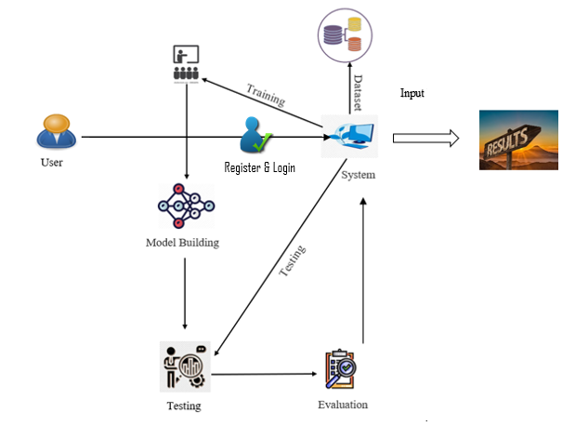
ARCHIECTURE

Slide 26
USE CASE DIAGRAM
A use case diagram in the Unified Modeling Language (UML) is a type of behavioral diagram defined by and created from a Use-case analysis. Its purpose is to present a graphical overview of the functionality provided by a system in terms of actors, their goals (represented as use cases), and any dependencies between those use cases. The main purpose of a use case diagram is to show what system functions are performed for which actor. Roles of the actors in the system can be depicted.

Slide 27
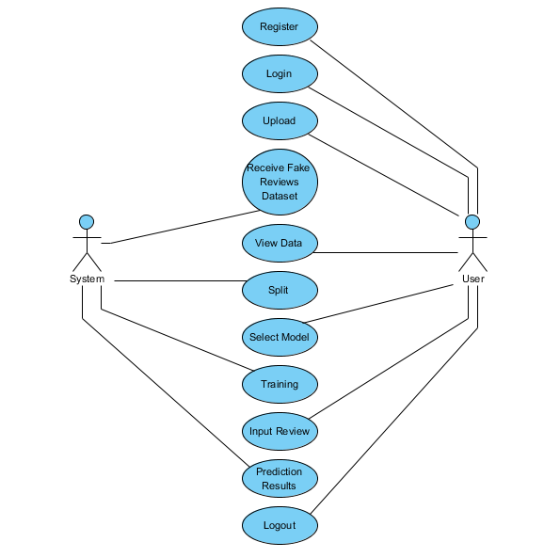

Slide 28
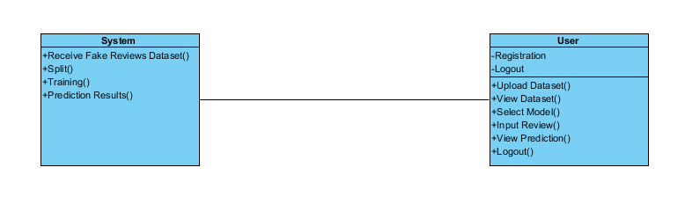
CLASS DIAGRAM
In software engineering, a class diagram in the Unified Modeling Language (UML) is a type of static structure diagram that describes the structure of a system by showing the system's classes, their attributes, operations (or methods), and the relationships among the classes. It explains which class contains information.

Slide 29
SEQUENCE DIAGRAM
A sequence diagram in Unified Modeling Language (UML) is a kind of interaction diagram that shows how processes operate with one another and in what order. It is a construct of a Message Sequence Chart. Sequence diagrams are sometimes called event diagrams, event scenarios, and timing diagrams.

Slide 30
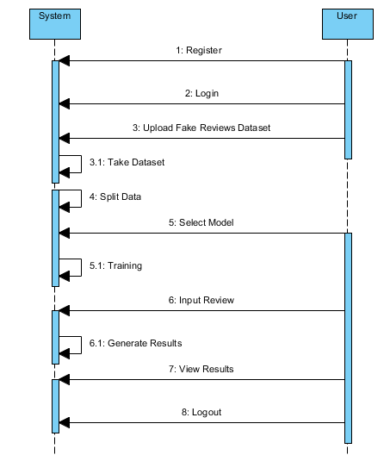

Slide 31
COLLABORATION DIAGRAM
In collaboration diagram the method call sequence is indicated by some numbering technique as shown below. The number indicates how the methods are called one after another. We have taken the same order management system to describe the collaboration diagram. The method calls are similar to that of a sequence diagram. But the difference is that the sequence diagram does not describe the object organization where as the collaboration diagram shows the object organization.

Slide 32
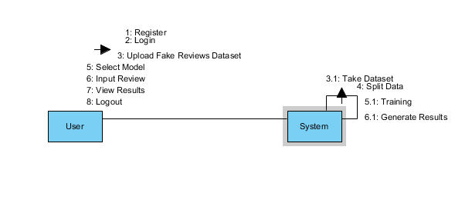

Slide 33
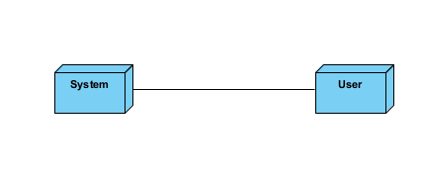
DEPLOYMENT DIAGRAM
Deployment diagram represents the deployment view of a system. It is related to the component diagram. Because the components are deployed using the deployment diagrams. A deployment diagram consists of nodes. Nodes are nothing but physical hardware used to deploy the application.

Slide 34
ACTIVITY DIAGRAM
Activity diagrams are graphical representations of workflows of stepwise activities and actions with support for choice, iteration and concurrency.
In the Unified Modeling Language, activity diagrams can be used to describe the business and operational step-by-step workflows of components in a system.
An activity diagram shows the overall flow of control.

Slide 35
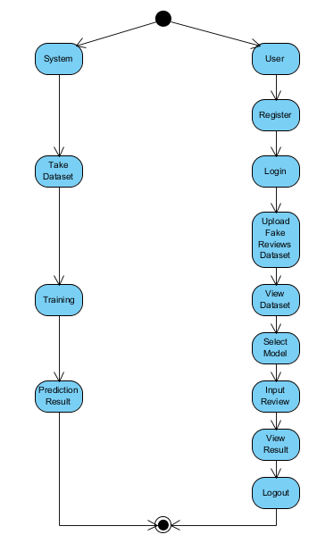

Slide 36
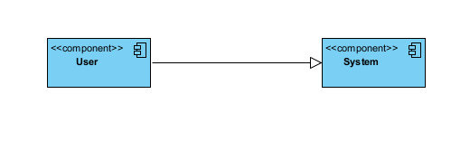
COMPONENT DIAGRAM
A component diagram, also known as a UML component diagram, describes the organization and wiring of the physical components in a system.
Component diagrams are often drawn to help model implementation details and double-check that every aspect of the system's required functions is covered by planned development.

Slide 37
ER DIAGRAM
An Entity–relationship model (ER model) describes the structure of a database with the help of a diagram, which is known as Entity Relationship Diagram (ER Diagram).
An ER diagram shows the relationship among entity sets. An entity set is a group of similar entities and these entities can have attributes.
In terms of DBMS, an entity is a table or attribute of a table in database, so by showing relationship among tables and their attributes, ER diagram shows the complete logical structure of a database.

Slide 38
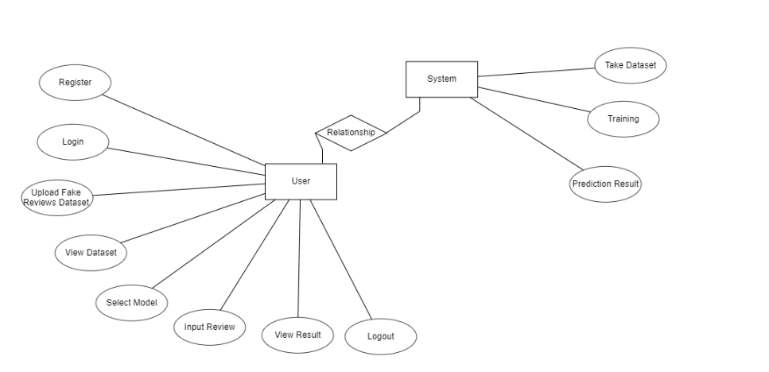

Slide 39
DF DIAGRAM
A Data Flow Diagram (DFD) is a traditional way to visualize the information flows within a system.
A neat and clear DFD can depict a good amount of the system requirements graphically. It can be manual, automated, or a combination of both.
It shows how information enters and leaves the system, what changes the information and where information is stored.
The purpose of a DFD is to show the scope and boundaries of a system as a whole.
It may be used as a communications tool between a systems analyst and any person who plays a part in the system that acts as the starting point for redesigning a system.

Slide 40
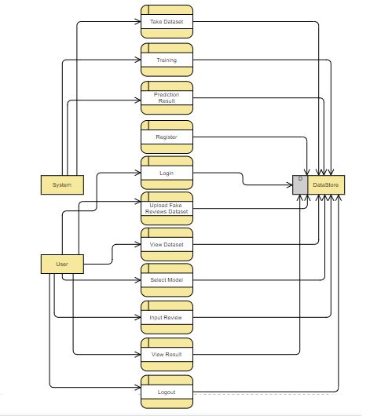

Slide 41
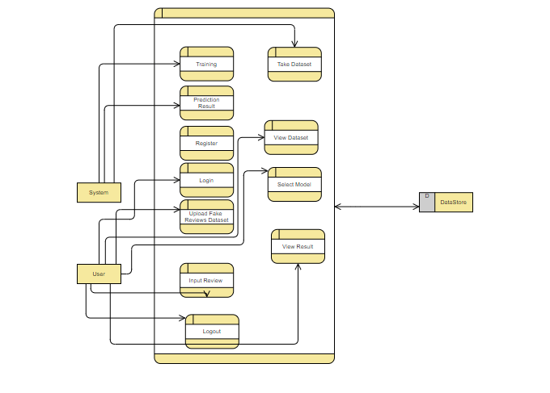

Slide 42

RESULTS
In our project, we are detecting the fake reviews from the review entered by the user.

Slide 43

Here the application describes what main objective of this project is.

Slide 44

Registration page in which user need to register to start.

Slide 45

Login page, user need to enter valid credentials in order to enter.

Slide 46

Upload Page in order to upload the dataset.

Slide 47
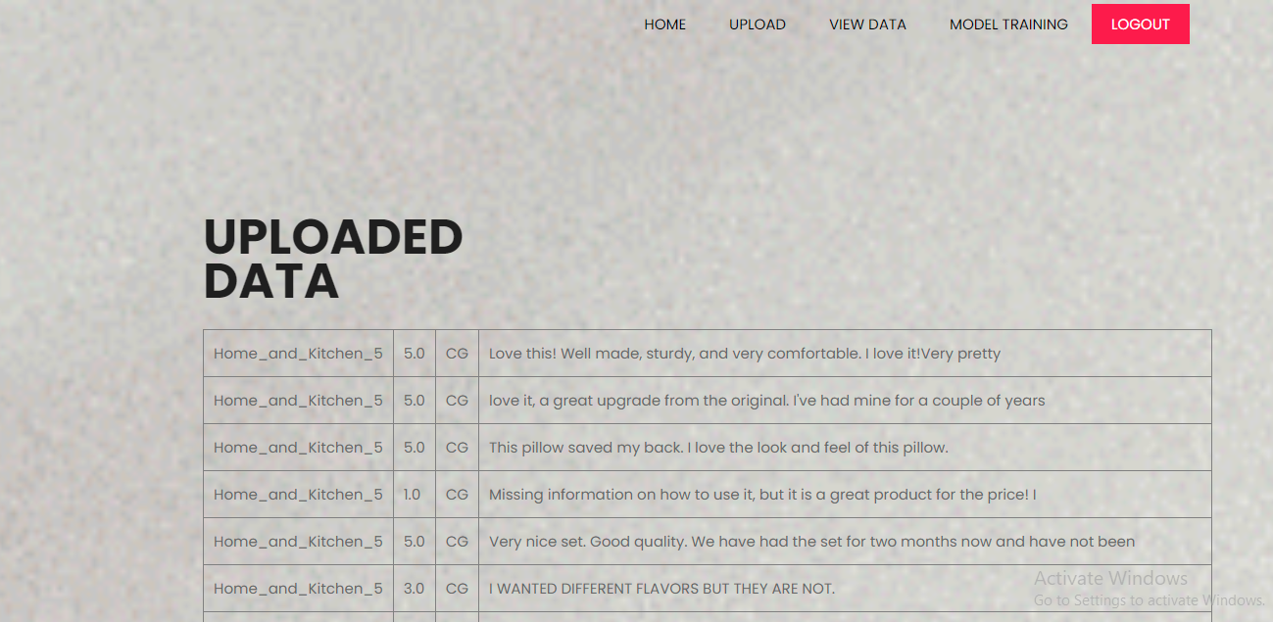
User views the data which he was uploaded to the system.

Slide 48
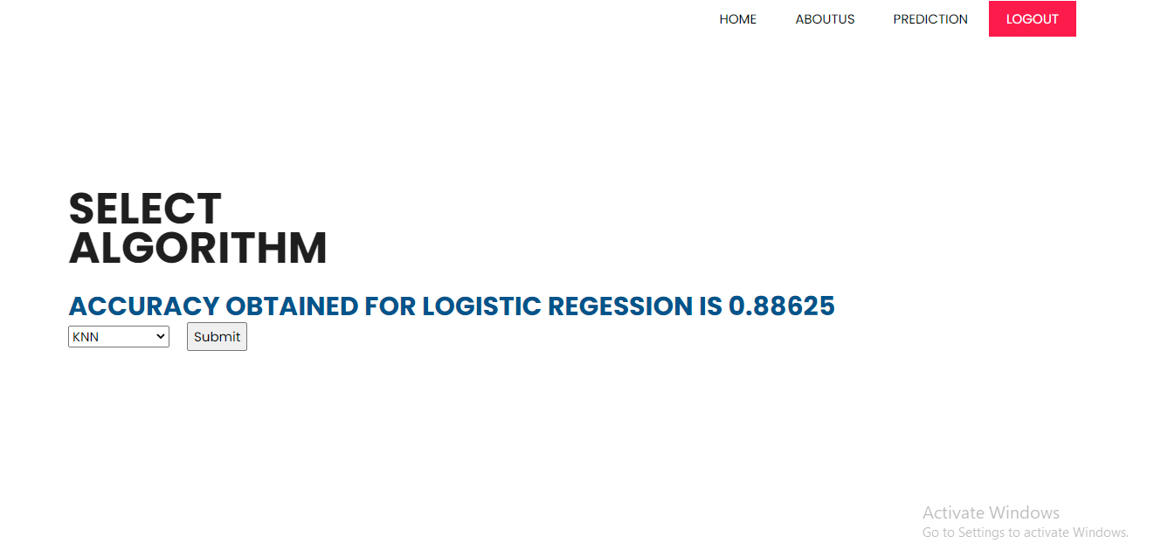
Here training of your model takes place and display the models accuracy score

Slide 49

User need to enter the required fields in order to get the response from the data whether the review is computer generated or original.

Slide 50
CONCLUSION
We have successfully developed a system to detect fake reviews in this application.
This is created in a user-friendly environment with Python programming and Django framework.
The system is likely to gather data from the user in order to determine whether the review is fake or not.

Slide 51
FUTURE SCOPE
The ability to identify numerous classifications could be added to this application in the future.
We intend to investigate prediction approach with the revised data set and employ the most accurate and relevant machine learning algorithms for detection.

Slide 52
REFERENCES
[1] R. Barbado, O. Araque, and C. A. Iglesias, “A framework for fake review detection in online consumer electronics retailers,” Information Processing & Management, vol. 56, no. 4, pp. 1234 – 1244, 2019.
[2] S. Tadelis, “The economics of reputation and feedback systems in e-commerce marketplaces,” IEEE Internet Computing, vol. 20, no. 1, pp. 12–19, 2016.
[3] M. J. H. Mughal, “Data mining: Web data mining techniques, tools and algorithms: An overview,” Information Retrieval, vol. 9, no. 6, 2018.

Slide 53
[4] C. C. Aggarwal, “Opinion mining and sentiment analysis,” in Machine Learning for Text. Springer, 2018, pp. 413–434.
[5] A. Mukherjee, V. Venkataraman, B. Liu, and N. Glance, “What yelp fake review filter might be doing?” in Seventh international AAAI conference on weblogs and social media, 2013.
[6] N. Jindal and B. Liu, “Review spam detection,” in Proceedings of the 16th International Conference on World Wide Web, ser. WWW ’07, 2007.

Slide 54


